Slide 1
Korea
Made by Zoárd Szabó 9/ny

Slide 2
Introdoction
I've chosen Korea because…
It is a very colorful country.
They’ve got a huge collection of music, culture, and history.
The language is very easy to learn.
The people are very friendly over there.The food is amazing over there.

Slide 3
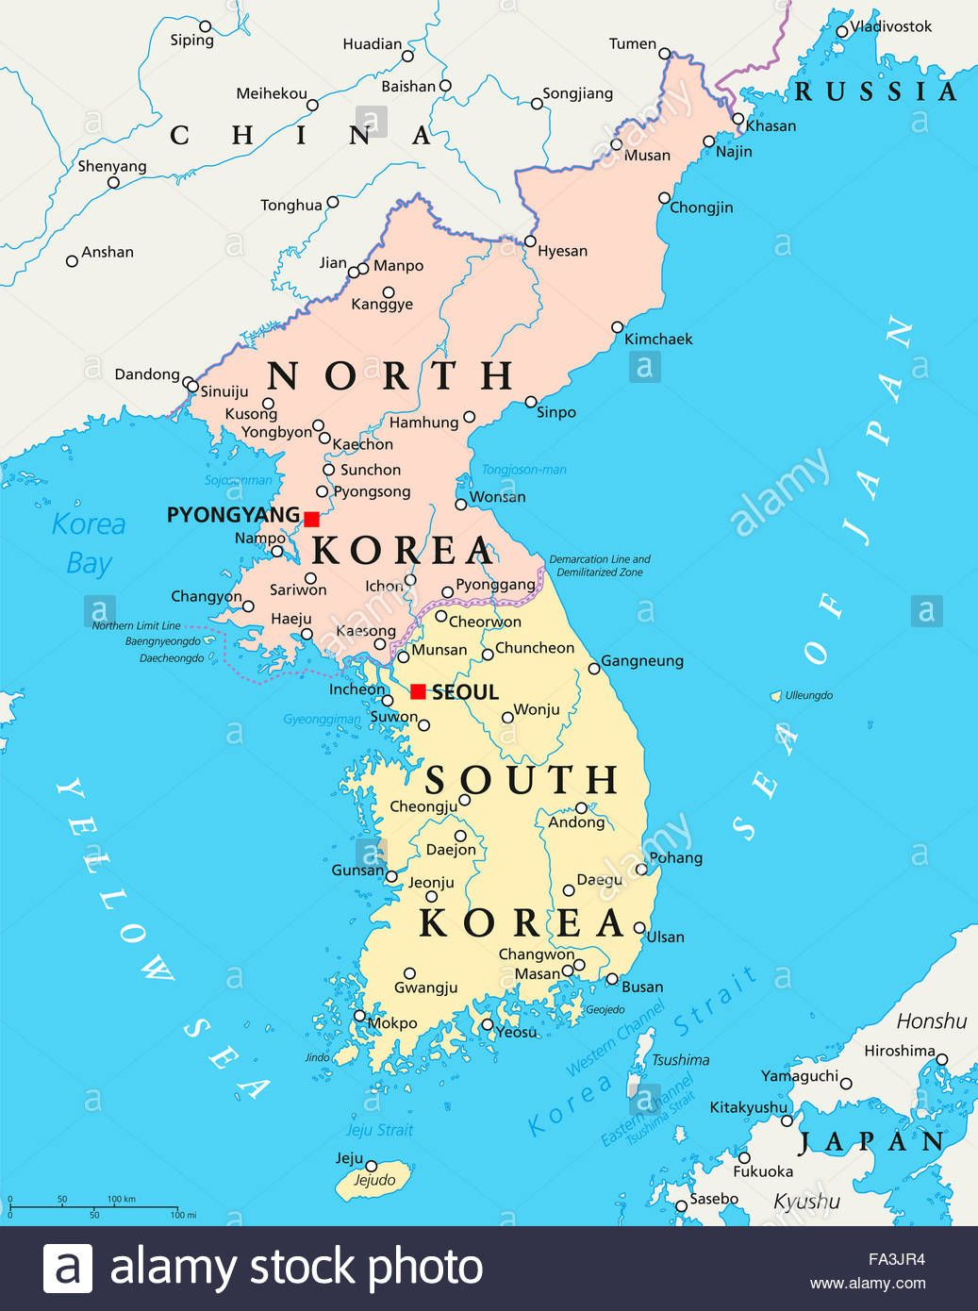
Geography
Apparently, Korea is divided between two leaders, as shown on the map on right.
Korea is divided by the Military Demarcation Line from 1953 to the present.
South Korea
North Korea
The country is largely mountainous, with small valleys and narrow coastal plains.
North Korea is a land of mountains and hills separated by deep, narrow valleys. Paektu-san, or "white head mountain" in the Korean language, is the country's tallest mountain, reaching 9,003 feet (2,744 meters).

Slide 4

History - South
Until the end of World War Two Korea was under Japanese control.
after the Second World War Korea was divided into two.
USA took controll over South Korea.

Slide 5
History - North
The northern part of Korea was taken over by the USSR.
the division was made on the 38th parallel.
since then North Korea has grown to be a powerful communist country.
On the 30th of April 2018, the current dictator of North Korea announced that they would use the Korean timezone too. So on the 5th of may the use of the Phenjan timezone officially ended.

Slide 6
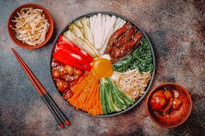
Culture
South Korea supports religious freedom
Confucianism, Buddhism and Christianity are the main formal religions
Many Koreans believe in the ancestral spirit and observe
Confucian rituals
Confucianism is a political and social philosophy that pervades Korean culture
The Korean culture features lots of different foods

Slide 7
Thank you for your attention.
Y’all bitches

